Slide 1

Nick Pepin
University of Portsmouth
Alex Prior
Coastal Partners
Samantha Box
Coastal Partners
Public lecture:
Saving the UK's only island city
www.portsmouthclimateaction.org.uk/

Slide 2
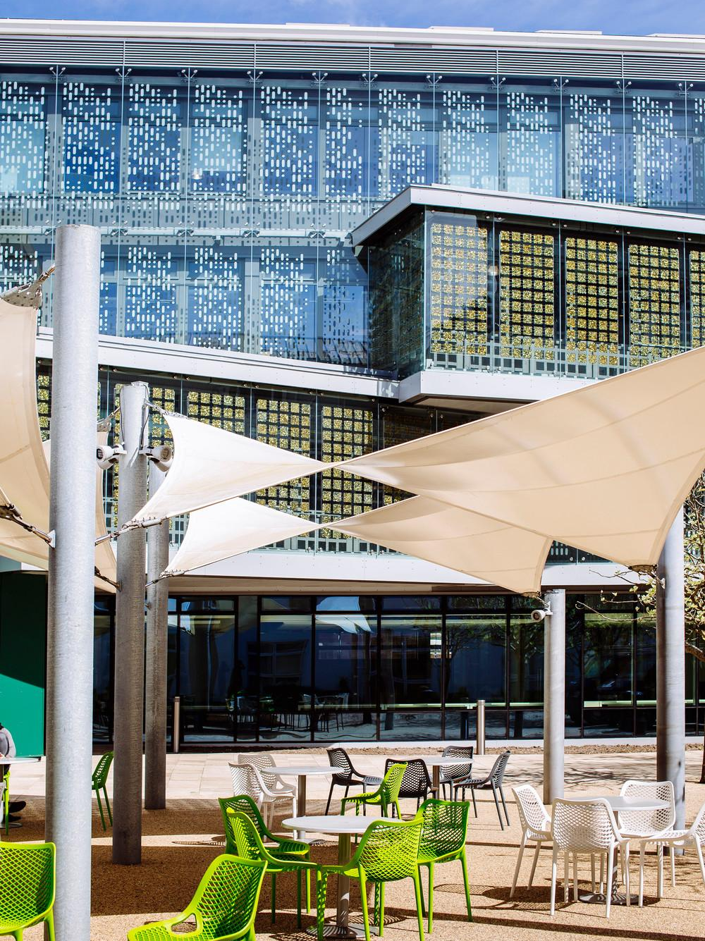
PORTSMOUTH: THE ISLAND CITY AND CLIMATE CHANGE. Our Changing Vulnerability
Dr Nick Pepin: University Public Lecture: 4 June 2025
School of Environment and Life Sciences

Slide 3
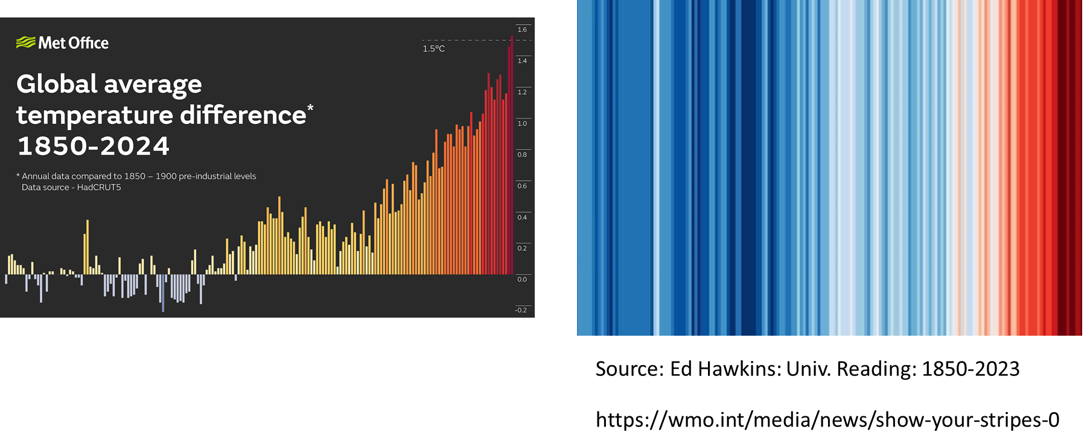
EVIDENCE OF CLIMATE CHANGE
Source Met Office HadCRUT5 dataset

Slide 4
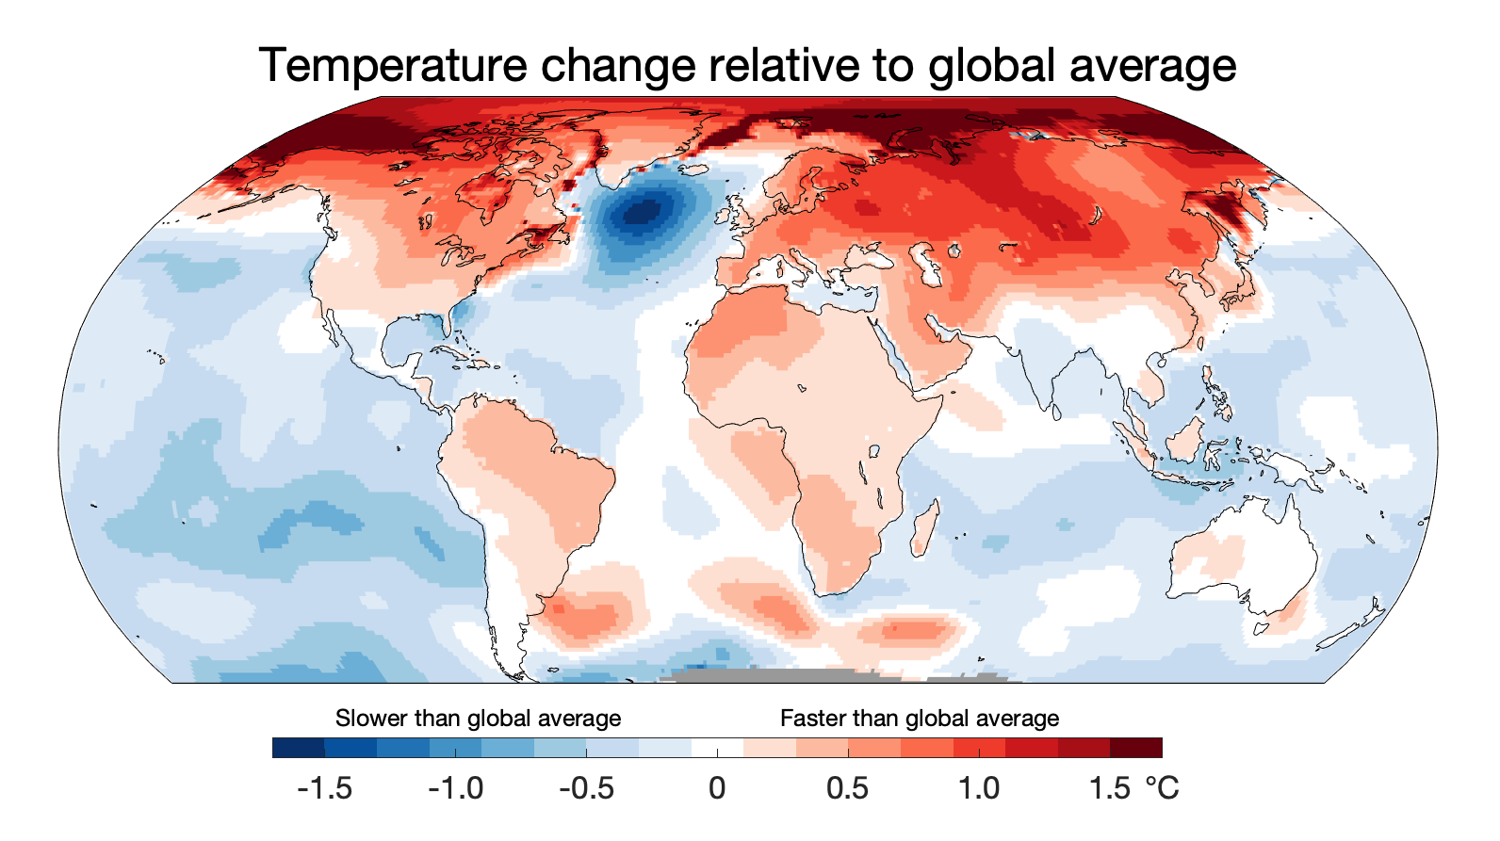
MAP OF TEMPERATURE CHANGE
Technical details: spatial pattern of warming uses approach described in Hawkins et al. (2020) using Berkeley Earth dataset, and the changes are relative to 1850-1900.

Slide 5
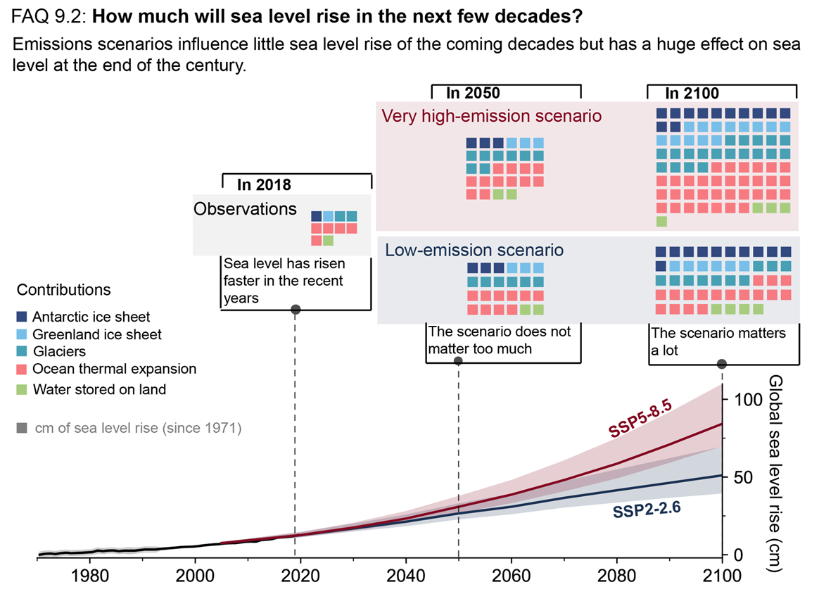
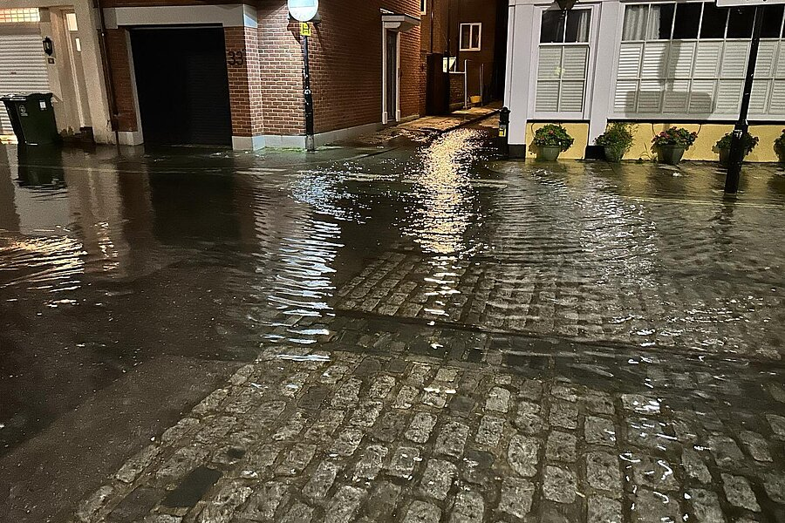
Consequences: Sea Level Rise
Source: Cllr Ian Holder
Flooding: Old Portsmouth 9 Apr 2024
High Tides a result of SLR
Best estimate: ~70 cm by 2100, high end 1-2 metres
https://weather.metoffice.gov.uk/climate-change/organisations-and-reports/past-and-future-sea-level-rise

Slide 6
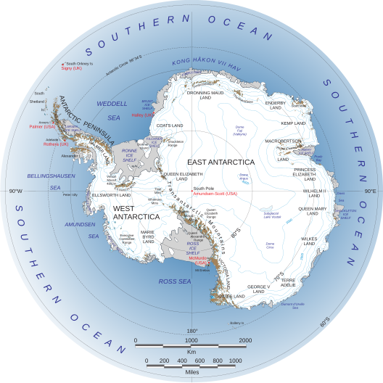
MUCH HIGHER RISES UNLIKELY BUT POSSIBLE
If ALL ice melted
Mountain glaciers and ice caps: 32 cm
Greenland Ice Sheet 7.4 m
West Antarctic Ice Sheet 5.3 m
East Antarctic Ice Sheet 52.2 m
low confidence projections of total sea level rise under SSP5-8.5 (highest emissions scenario) that might exceed +15 m at 2300 if ice sheets destabilised
https://en.wikipedia.org/wiki/Antarctic_ice_sheet

Slide 7
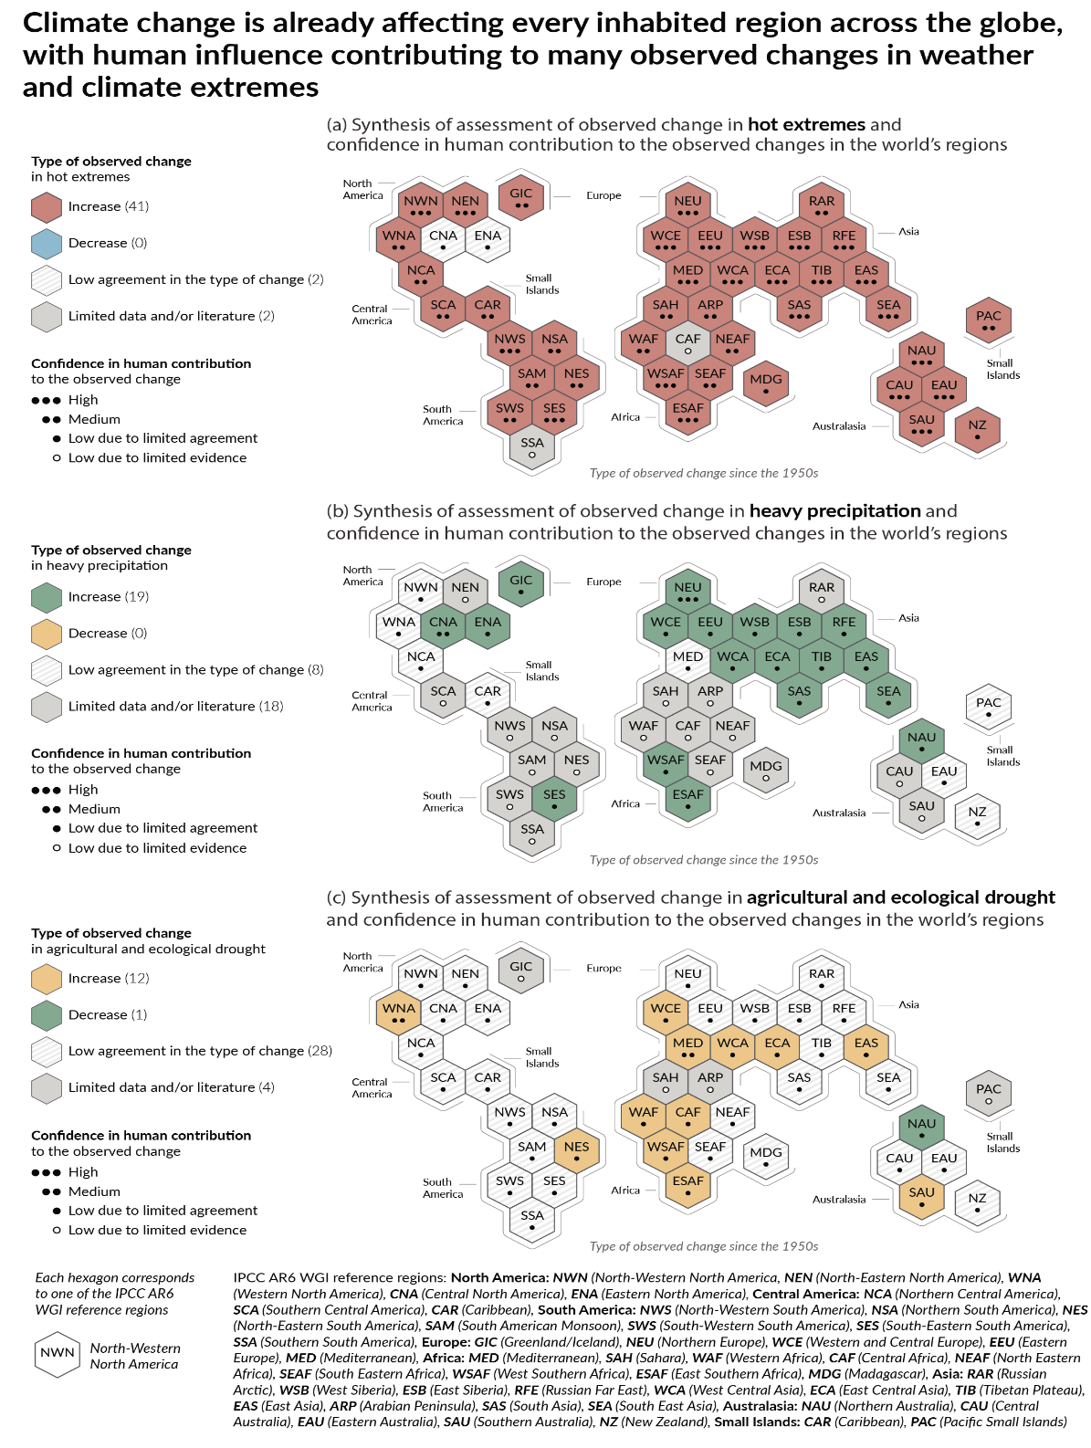
What else is changing?
Increasing hot temperature extremes
Increasing heavy precipitation events
Increasing agricultural and ecological drought (maybe not everywhere)
Source: IPCC AR6: Summary for Policymakers

Slide 8
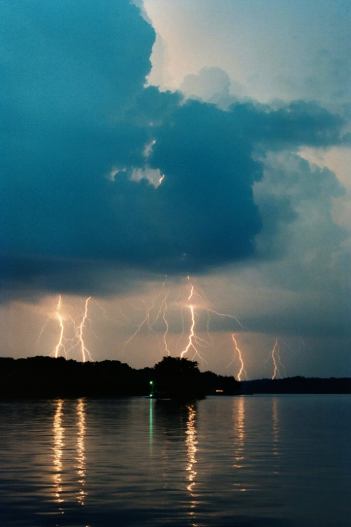
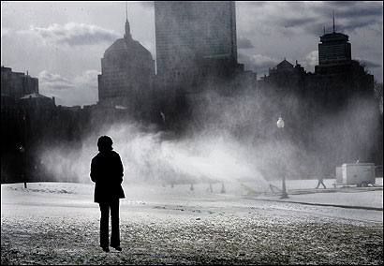
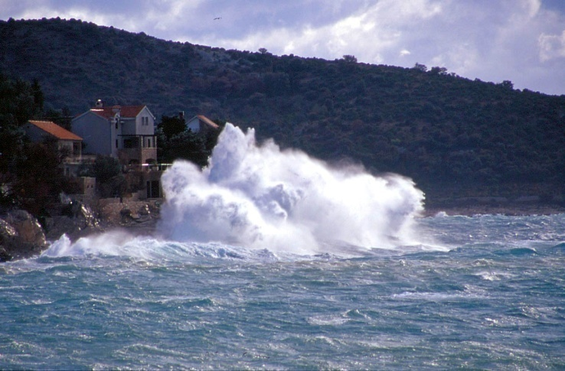
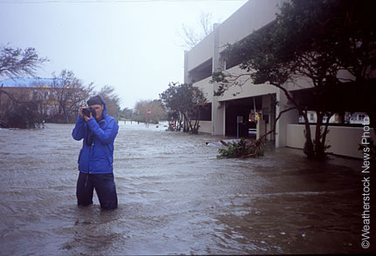
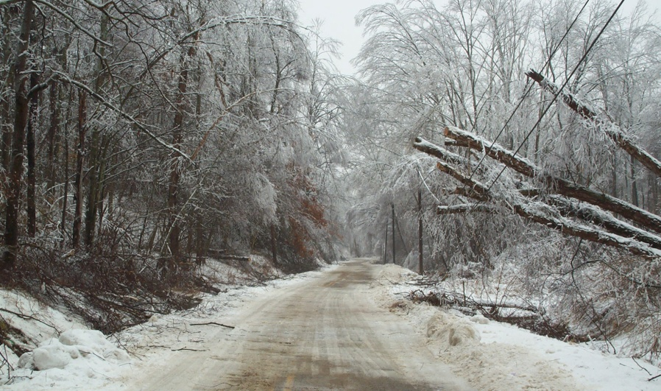
EXTREME WEATHER AND STORMS
WIND
WAVES
THUNDER
RAIN
SNOW/ICE

Slide 9
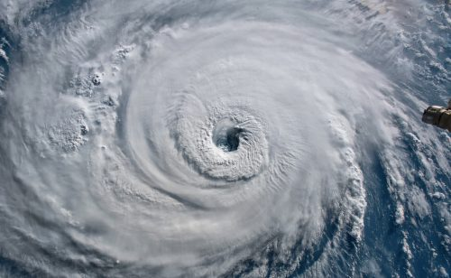
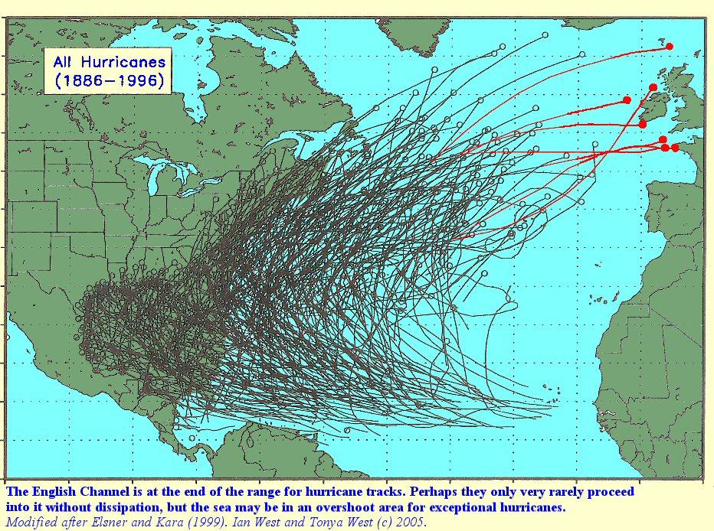
HURRICANES/TROPICAL STORMS
Source: Shutterstock
Increase in intensity because warmer oceans
Form over warm waters and move west, then recurve as they meet the mid-latitude westerlies which steer them to the east

Slide 10
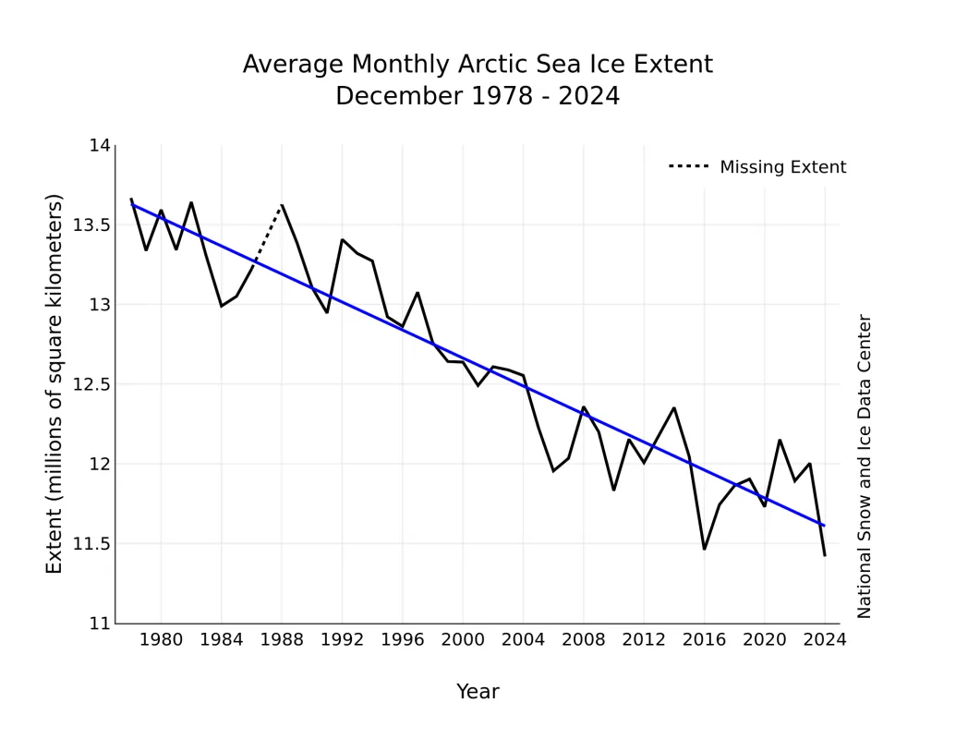
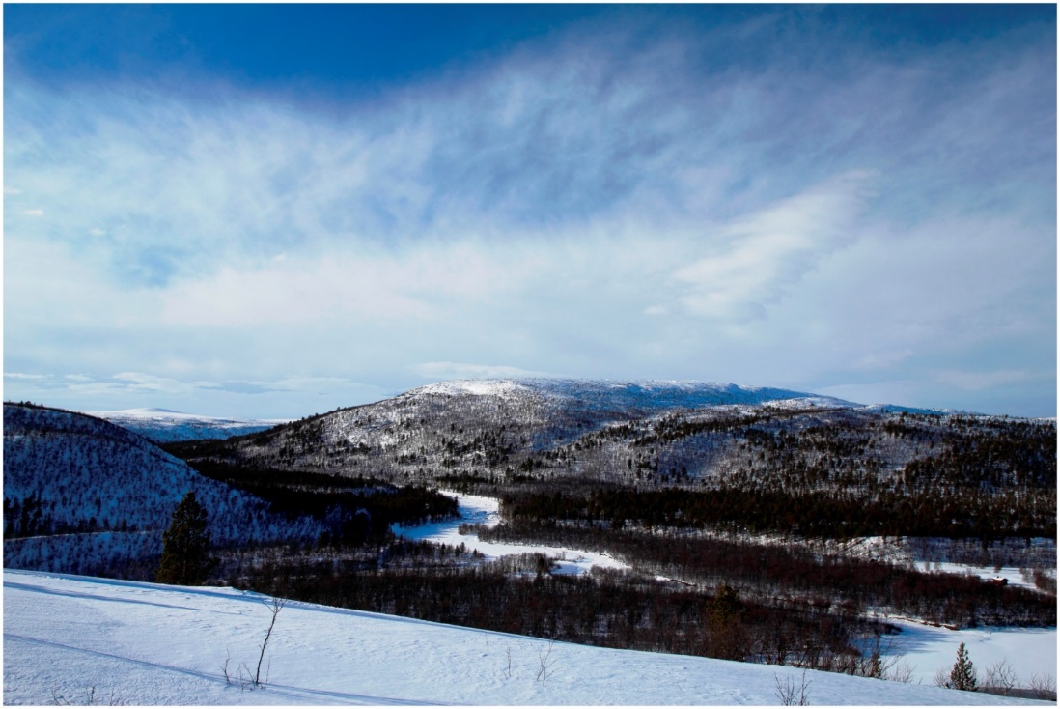
ARCTIC AMPLIFICATION
http://www.nsidc.org/
White snow and ice is melting
Dark vegetation is increasing (more trees)
This process amplifies warming in the poles, and reduces the temperature difference between the arctic and warmer places

Slide 11
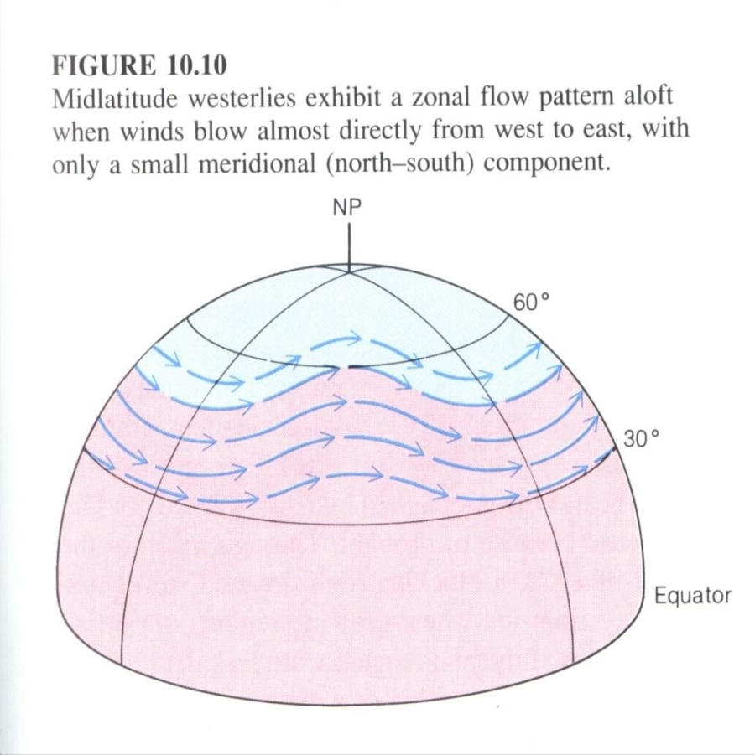
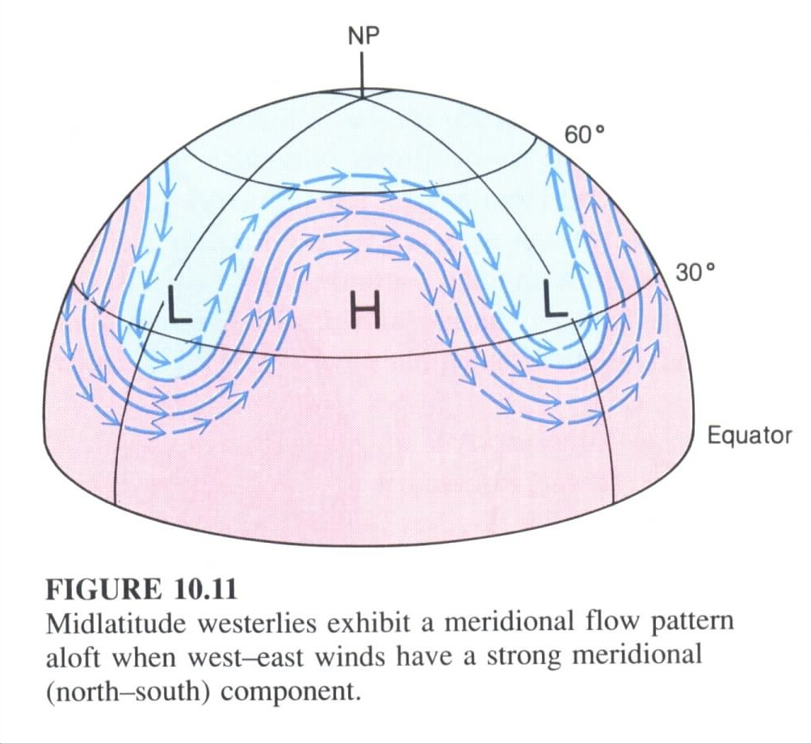
JET STREAM and STORM TRACKS
More hot and cold spells
Source: Moran and Morgan (1994)

Slide 12
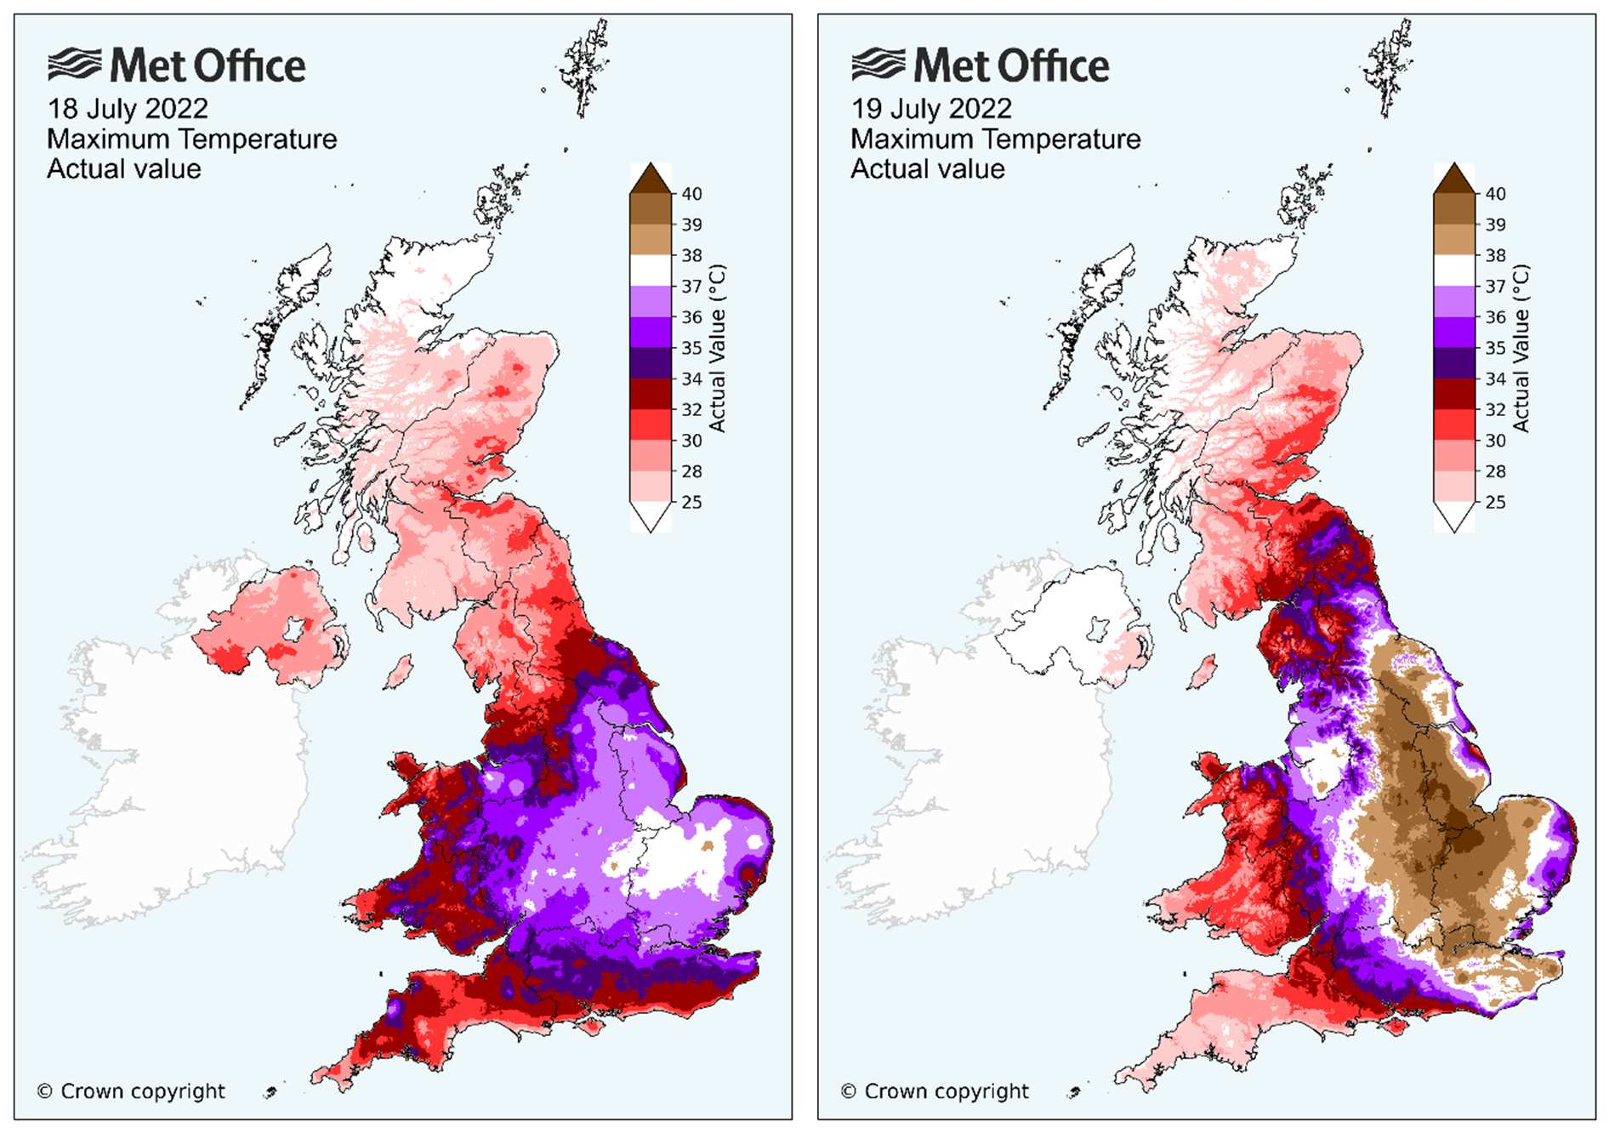
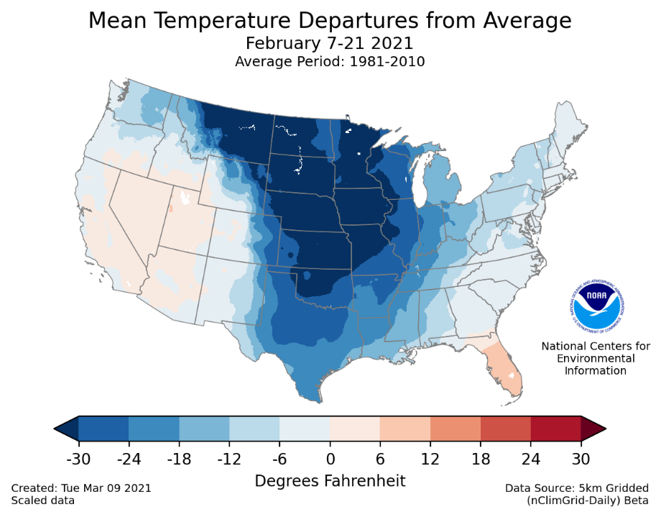
EXTREME MERIDIONAL FLOW: HEATWAVES AND COLD SPELLS INCREASE
Example: Texas coldwave: Feb 2021, caused by trough in the westerlies

Slide 13
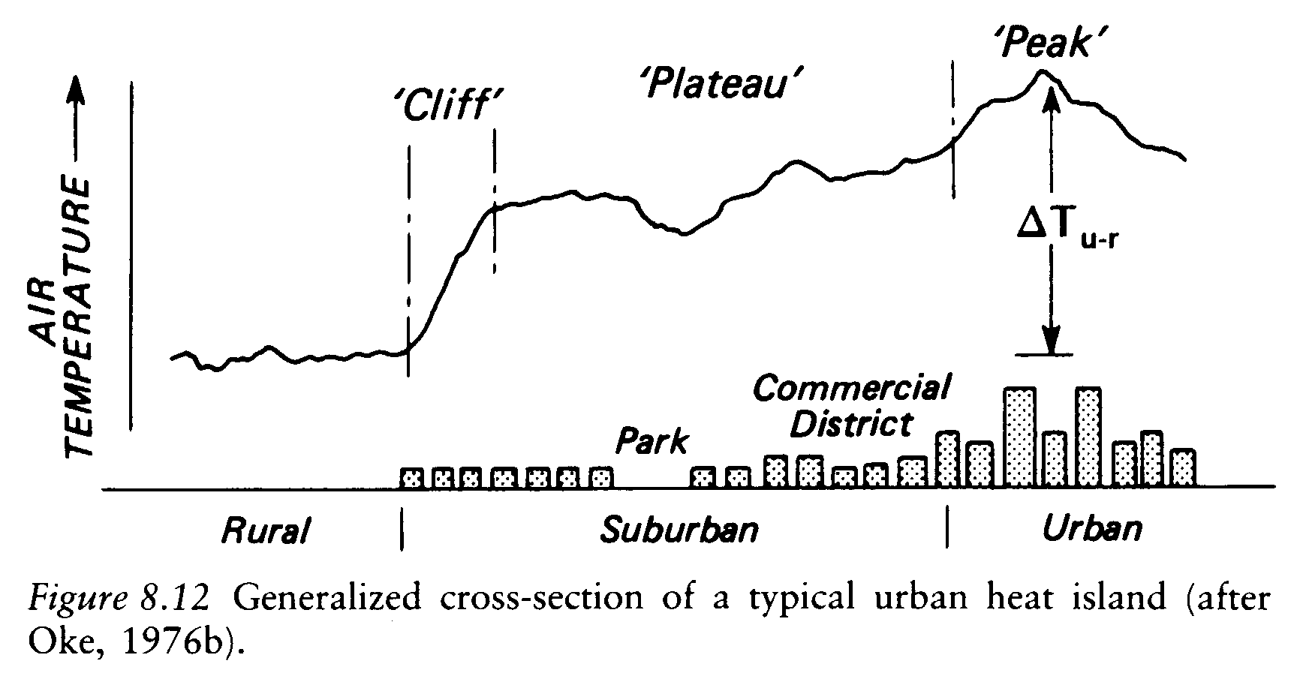
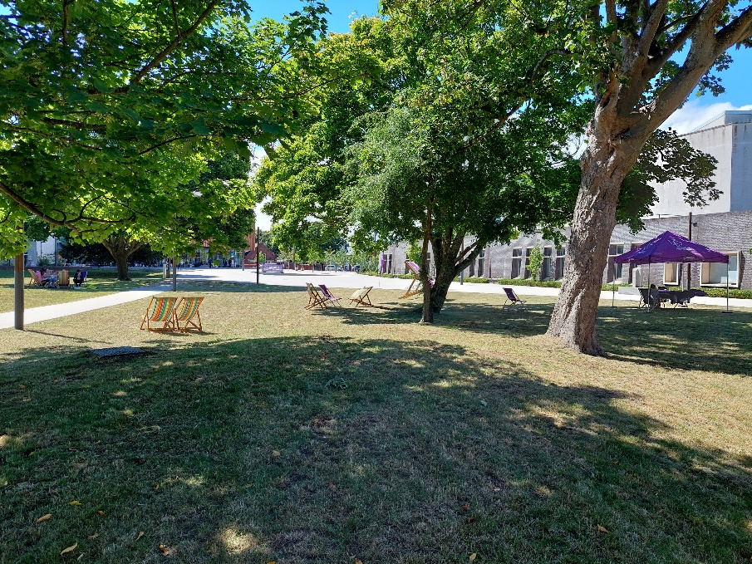
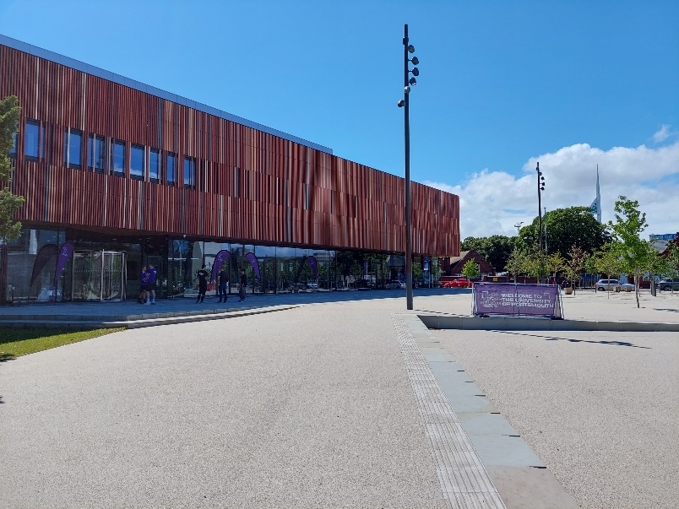
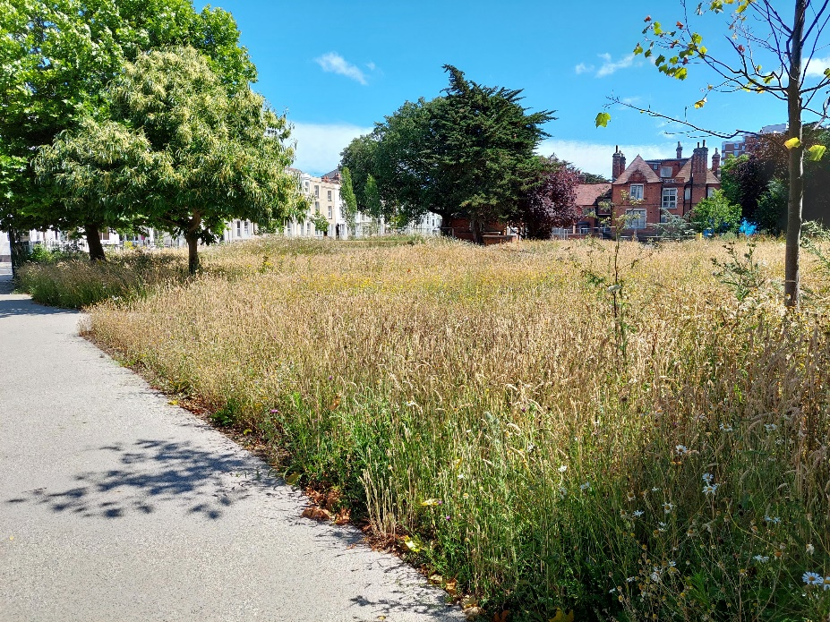
HEATWAVES AND THE URBAN HEAT ISLAND
Trees, Vegetation and Water Reduce the UHI through Evapotranspiration
Tarmac and Concrete Absorb Heat and Reradiate
Water Flows Off

Slide 14
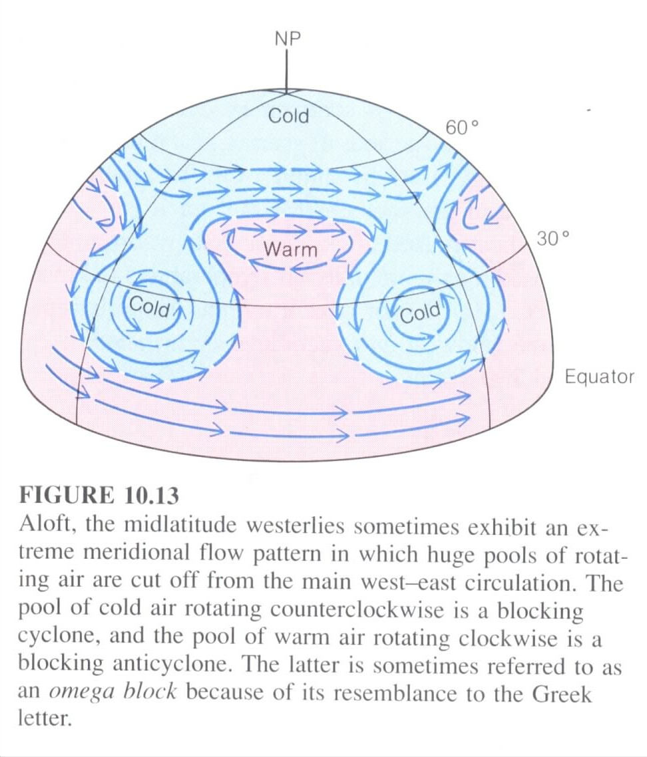
JET STREAM MEANDERS and STAGNATION
Sometimes jet stream creates great meanders
Cut off lows and blocking highs
Lows: cold air: storms and heavy rainfall
Highs: warm air: droughts and heat
Stagnancy is an issue: prolonged weather
Source: Moran and Morgan (1994)

Slide 15
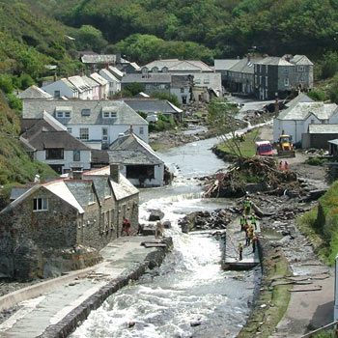
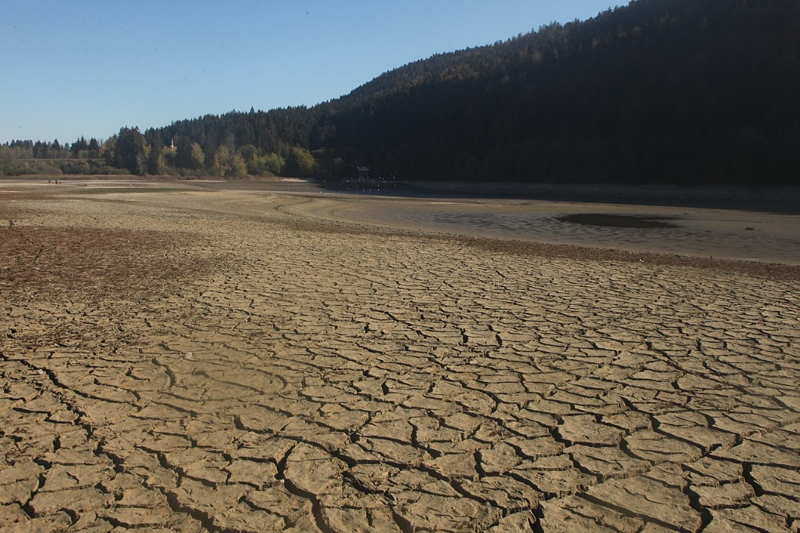
MORE FLOODS and DROUGHTS
Drought and heatwaves in Europe (2018, 2022)
Boscastle flash floods in August 2004

Slide 16
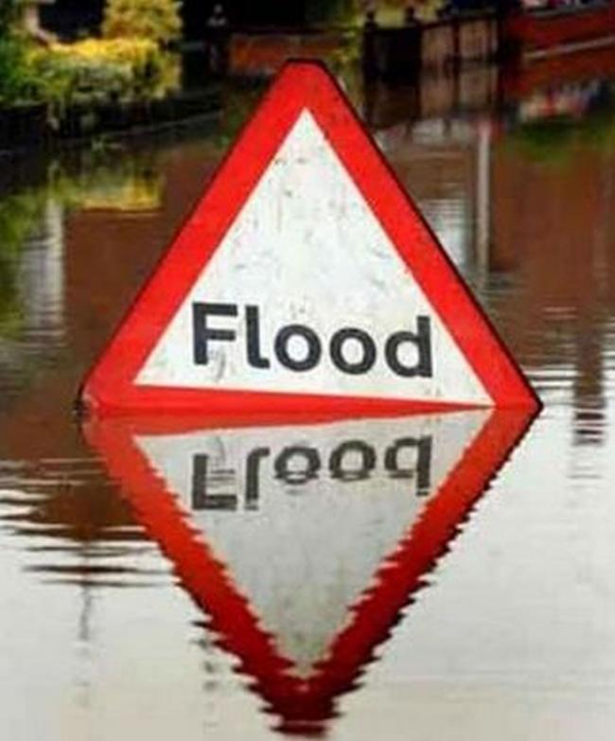
Atmospheric Moisture and Intense Rainfall Events
Warmer air can hold more moisture so this can increase the intensity of heavy rainfall events.
For every 1 degree of warming, 6.5% increase in moisture content
Intensification of the hydrological cycle
See
http://www.sciencedirect.com/science/article/pii/S0022169405003215
Urban greening also good for water retention
http://www.dorsetecho.co.uk

Slide 17
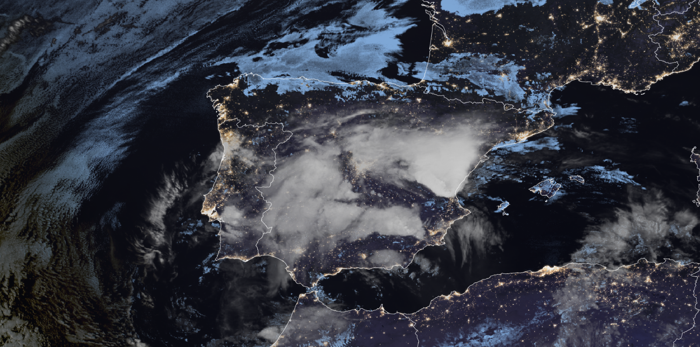
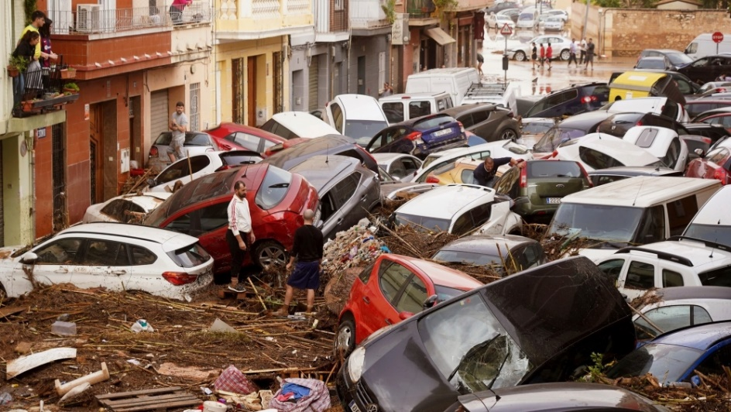
Gota Fria in Spain in October 2024
By EUMETSAT - https://view.eumetsat.int/productviewer?v=default, Public Domain, https://commons.wikimedia.org/w/index.php?curid=154902722
Warmer ocean
More moisture in atmosphere
Stagnation of low pressure system
Urbanisation and deforestation
https://www.javeamigos.com/spain-declares-three-days-of-official-mourning-for-the-victims-of-the-savage-gota-fria/

Slide 18
FUTURE CLIMATE HAZARDS and IMPACTS IN PORTSMOUTH: A SUMMARY
Insurance for homeowners – particularly flooding
but also wind and structural damage: £585 million (ABI) damages in 2024
Disruption to transport infrastructure and economic activity
Loss of life (can be direct impacts in storms) but also less obvious (excess deaths among the elderly in heatwaves)
Crop failure and increased food prices
Damage to coastal ecosystems
Damage to tourism and city reputation/finances
The cost of doing nothing is not nothing
Increase in sea-level and coastal flooding/inundation
Increased heatwaves and high temperatures
Increased urban flooding due to more intense precipitation events (more moisture)
Increased droughts
Possible increase in strong windstorms and coastal erosion – this is slightly less clear (mostly winter and autumn)

Slide 19
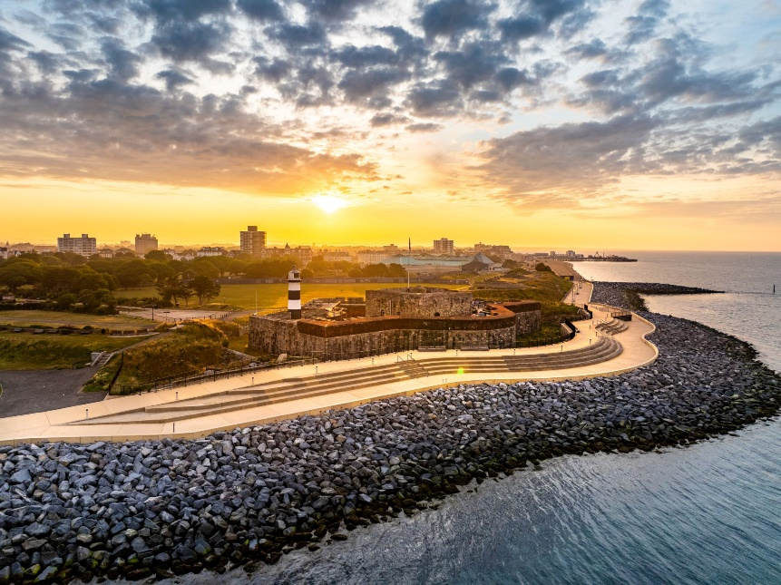
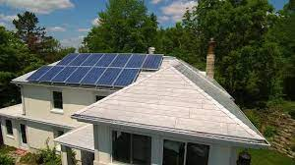
CLIMATE MITIGATION
Credit: Marcin Jedrysiak
Sea Defences (sea level rise, wind storms and managing coastal erosion)
Increasing Parks and Urban Greening (both for heat mitigation and water retention when heavy rainfall)
Use of reflective materials (cooling)
Ensure building spacing provides adequate ventilation and shade but also handles strong winds when they occur
https://southseacoastalscheme.org.uk/
New Steel Roofers Inc.

